Slide 1

Sampling tools: the Bootstrap
?
Slides by:
Deborah Nolan deborah_nolan@berkeley.edu
Sp18 updates: Fernando Perez fernando.perez@Berkeley.edu

Slide 2
NO OH Today for me

Slide 3
Recap:
Population – Group that we want to generalize our findings to (What we expect)
Data Production – How the sample is generated from the population
Sample – What we get

Slide 4
Recap – Study the Sampling Distribution of a Statistic
Probability Theory
Simple Monte Carlo Simulation
Bootstrap our sample

Slide 5
Estimators we will investigate:
Mean (did that)
75th percentile (bootstrap)
Proportion (just like a mean)

Slide 6
The Central Limit Theorem

Slide 7
The Central Limit Theorem
In most situations, the distribution of the means of independent random variables tends towards a normal distribution, regardless of their original distribution.
There are conditions: e.g. original distribution must have finite variance.
???
Notes:
{\displaystyle {\sqrt {n}}\left(\left({\frac {1}{n}}\sum _{i=1}^{n}X_{i}\right)-\mu \right)\ {\xrightarrow {d}}\ N\left(0,\sigma ^{2}\right).}

Slide 8
The Central Limit Theorem
Suppose {X₁, X₂, …} is a sequence of i.i.d. random variables with E[X_{i}] = µ and Var[X_{i}] = σ² < ∞. Then as n approaches infinity, the random variables √n(S_{n} − µ) converge in distribution to a normal N(0,σ²):

Slide 9
For uniform distribution, σ² = 1/12

Slide 10
Example: Restaurant Health inspections in SF

Slide 11
Population
All 4543 restaurants in San Francisco in 2016
Measurement of interest: we are interested in whether the inspection score for a restaurant exceeds 95

Slide 12
Population Distribution
94: 403
96: 524
98: 304
100: 656
So we see that 1484 of the 4543 restaurants have a score over 95 – i.e., 32.7%

Slide 13
Population Distribution
It’s easiest to work with a dummy variable, or an indicator.
Here the restaurant’s value is either 1 or 0, depending on whether or not its score exceeds 95.
1484 of the 4543 restaurants have 1 for the dummy value.

Slide 14
Population Parameter
Population distribution
Two unique values: 0 and 1
p - proportion of restaurants with a 1 and (1-p) proportion of 0s
Population parameter that minimizes L² error:
Leave it as an exercise for you to show that θ* = p
In our example p = 0.3266 ~ 1/3

Slide 15
D – result of 1 draw from the population
What values does D take on?
What is the chance D takes on each value?
Value | 0 | 1
Chance | ~2/3 | ~1/3

Slide 16
Expected Value
Expected value:
Variance:

Slide 17
D₁ , D₂ – result of 2 draws from the population with replacement
The probability distribution of D₂ is the same as for D₁
We can also examine the joint probability distribution of (D₁,D₂)
 |  | D₂
 |  | 0 | 1
D₁ | 0 | 0.49 | 0.21
 | 1 | 0.21 | 0.09
Where does this number come from?

Slide 18
Two Ways to find P(D₁=1, D₂=1)
Count the possibilities:
4543 x 4543 possible pairs
Of these 1484 x 1484 are pairs with both 1s
(1484 x 1484)/(4543 x 4543) ≈ 0.3²
Work conditionally
P(D₁=1, D₂=1) = P(D₁=1)P(D₂=1|D₁=1)
= P(D₁=1)P(D₂=1)
For both to be 1, The first must be one and given that information the second must be 1.
Since we replace between draws, the chance the second is 1 is not affected by the value of the first draw.

Slide 19
What is P(D₁=1, D₂=1) if we sample without replacement?
Count the possibilities:
4543 x 4542 possible pairs
Of these 1484 x 1483 are pairs with both 1s
(1484 x 1483)/(4543 x 4542) ≈ 0.3²
Work conditionally
P(D₁=1, D₂=1) = P(D₁=1)P(D₂=1|D₁=1)
= P(D₁=1)1483/4542
For both to be 1, The first must be one and given that information the second must be 1.
Since we do not replace between draws, the chance the second is 1 is impacted by the value of the first draw.

Slide 20
Joint Distribution and Marginal Distribution
The Joint distribution of D₁ and D₂ gives the probabilities for the pair, e.g. P(D₁=1, D₂ =0)
The marginal probability for D₁ gives the probability for each value of D₁, regardless of the value of D₂. Both D₁ and D₂ have the same marginal probability whether we draw with or without replacement.
Also: P(D₁ = 1) = P(D₁=1, D₂ =0) + P(D₁=1, D₂ =1) That is, we can recover the marginal probabilities by summing across the column (or down the row) of our joint probability table

Slide 21
Expected Value of
Definition of Expected value
Separate into 2 sums and Apply the property of Marginal Probability

Slide 22
Variance of
Bring p inside parens
Expand the square
Why is this 0?
Need to use independence: E(XY) = E(X)E(Y) if X and Y are independent
and E(D) = p
Variances D₁ and D₂ are the same

Slide 23
estimator for population parameter

Slide 24
Here is our sample: 100 restaurants
If we only want to make statements about the sample, then we simply minimize the average loss
And get the proportion of restaurants with scores over 95 in our data – 0.31

Slide 25
If we want to generalize to the population of all
We know:
The sample should look like the population
The sample proportion is an estimator for the population proportion
But if we want to also indicate how much our estimate might vary, we either
rely on the Central Limit Theorem
Or we bootstrap

Slide 27
The Distribution of an Estimator
Resampling the population to estimate the sample distribution.
Population
Variability in my estimation procedure.
Sample 1
Sample 2
Sample 3
Confidence
Interval
7.6 Billion People

Slide 28
Law of Large Numbers
Describes the relationship between sample mean and the population mean.
As the sample size grows the sample mean approaches the population mean.

Slide 29
Bootstrap the Distribution of an Estimator
Simulation method to estimate the sample distribution.
Pretend this is your population!
Population
Bootstrap Samples
Variability in my estimation procedure.
Sample
Sample with replacement
Confidence
Interval
7.6 Billion People

Slide 30
Bootstrap the Distribution of an Estimator
Simulation method to estimate the sample distribution.
Pretend this is your population!
Population
Bootstrap Samples
Variability in my estimation procedure.
Sample
Sample with replacement
Confidence
Interval
7.6 Billion People

Slide 31
Boot Strap Confidence Interval
Construct a 95% confidence interval by taking the 2.5% and (100 - 2.5)% quantiles
95%
2.5%
2.5%

Slide 32
Core Idea
We generate bootstrap samples from the bootstrap population in a similar manner as the way the sample was generated from the population –
To Do This We Need To Know the Chance Process That Generated Our Data
We compute the bootstrap statistic from the bootstrap sample, in the same way we compute the statistic from the sample

Slide 33
Core Idea
bootstrap sample relation to bootstrap population
≈ sample relation to the population
bootstrap statistic’s distribution shape & variability
≈ statistic’s distribution shape and variability

Slide 34
Bootstrapping the sample proportion
Use the sample as the bootstrap population
Draw a sample of 100 with replacement from the bootstrap population
Calculate the proportion of scores over 95
Repeat steps 2 and 3 many times

Slide 35
Bootstrap sample proportion
Notice that our bootstrap proportions look roughly normal but there are funny gaps
The red dot is the true population proportion
The green interval is the inner 95% of the bootstrapped distribution (0.22, 0.40)

Slide 36
Bootstrap Confidence Interval
The green interval is the inner 95% of the bootstrapped distribution (0.22, 0.40)
It’s a confidence interval for the true proportion.
Notice that the true proportion is in the interval
Does this always happen?

Slide 37
Simulate 100 Bootstrap Confidence Intervals
Take a SRS of 100 from our population
Bootstrap 4000 sample proportions from this sample
Find the 95% of the bootstrap sampling distribution of the proportion
Repeat 100 times to get 100 95% confidence intervals

Slide 38
Simulate 100 95% Bootstrap Confidence Intervals
If the bootstrap is a good procedure, we expect the interval to cover the true parameter 95% of the time.
With 100 intervals, we expect 95 to cover the true parameter (the population proportion).
In our example 94 cover it
These interval estimates are more informative than a simple point estimate. They give a sense of the accuracy of our estimator

Slide 39
2. Monte Carlo Simulation

Slide 40
Simple Monte Carlo Simulation
Take a random sample of n from the population
Compute a statistic (parameter estimate) from the sample
Repeat R times to get R sample statistics (estimates)
pd.Series([
population.sample(n, replace = False).compute_stat()
for _ in range(R)
])

Slide 41
Monte Carlo vs Vegas
Monte Carlo: a randomized algorithm whose output may be incorrect (typically with small probability).
Las Vegas: a randomized algorithm that always gives correct results: it either finds the right answer or informs that it can’t.
“a Las Vegas algorithm does not gamble with the correctness of the result; it gambles only with the resources used for the computation.” – Wikipedia
We use MC algorithms more widely than LV ones.

Slide 42
Sampling Distribution
The main idea in a simulation study is to replace the mathematical expression for the probability distribution of a statistic (called the sampling distribution) with a simulated distribution
So we generate many (R) samples of size n, and study the behavior of the R values of the statistic
The Law of Large Numbers says that the average of our R statistics will be close to the expected value of the statistic, if R is large.

Slide 43
Approximate Sampling Distribution
The average of R sample statistics is close to the Expected value of the statistic
The SD of the R sample statistics is close to the SE of the statistic
The simulated distribution of the statistic is roughly the sampling distribution of the statistic

Slide 44
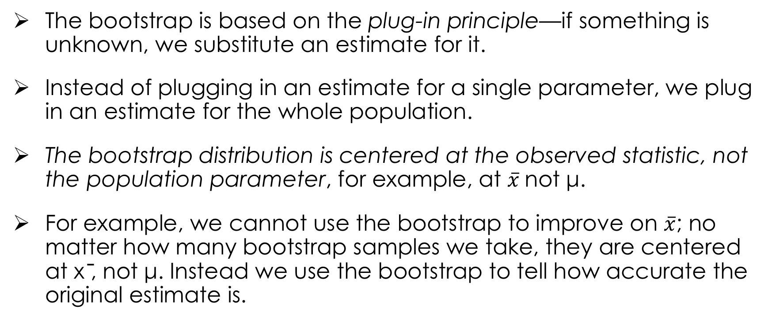
What Teachers Should Know About the Bootstrap: Resampling in the Undergraduate Statistics Curriculum Tim C. Hesterberg (2015)
The bootstrap is based on the plug-in principle—if something is unknown, we substitute an estimate for it.
Instead of plugging in an estimate for a single parameter, we plug in an estimate for the whole population.
The bootstrap distribution is centered at the observed statistic, not the population parameter, for example, at $\overline{x}$not μ.
For example, we cannot use the bootstrap to improve on $\overline{x}$; no matter how many bootstrap samples we take, they are centered at x ̄, not μ. Instead we use the bootstrap to tell how accurate the original estimate is.

Slide 45
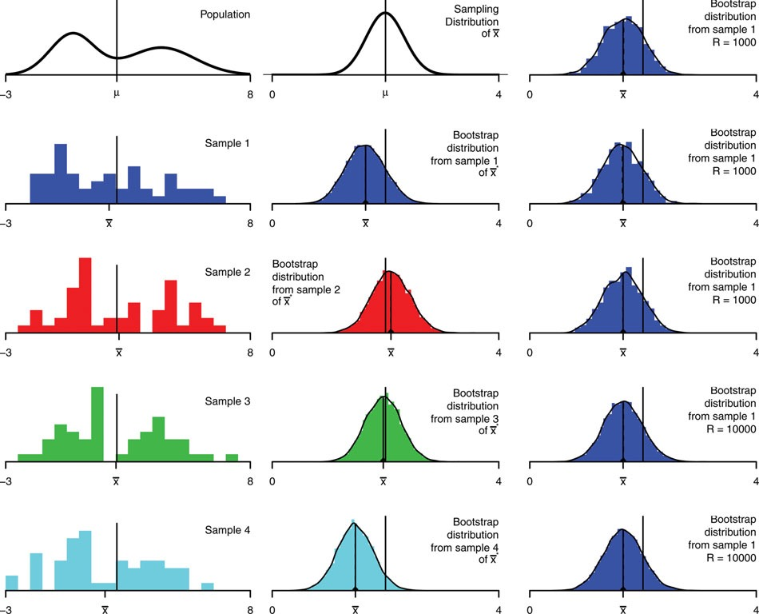
Bootstrap for the mean, n=50
From Tim C. Hesterberg (2015)
Notes:
Bootstrap distribution for the mean, n = 50. The left column shows the population and four samples. The middle column shows the sampling distribution for X ̄ , and bootstrap distributions of X ̄ ∗ for each sample, with r = 104 . The right column shows more bootstrap distributions for the first sample, three with r = 1000 and two with r = 104.

Slide 46
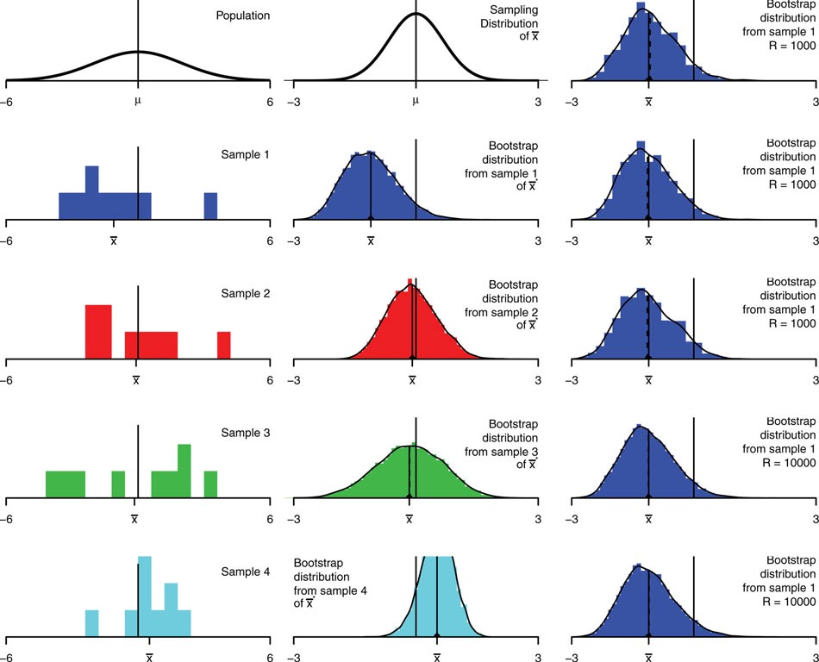
Bootstrap distributions for the mean, n = 9
Notes:
Bootstrap distributions for the mean, n = 9. The left column shows the population and four samples. The middle column shows the sampling distribution for X ̄ , and bootstrap distributions of X ̄ ∗ for each sample, with r = 104 . The right column shows more bootstrap distributions for the first sample, three with r = 1000 and two with r = 104.

Slide 47
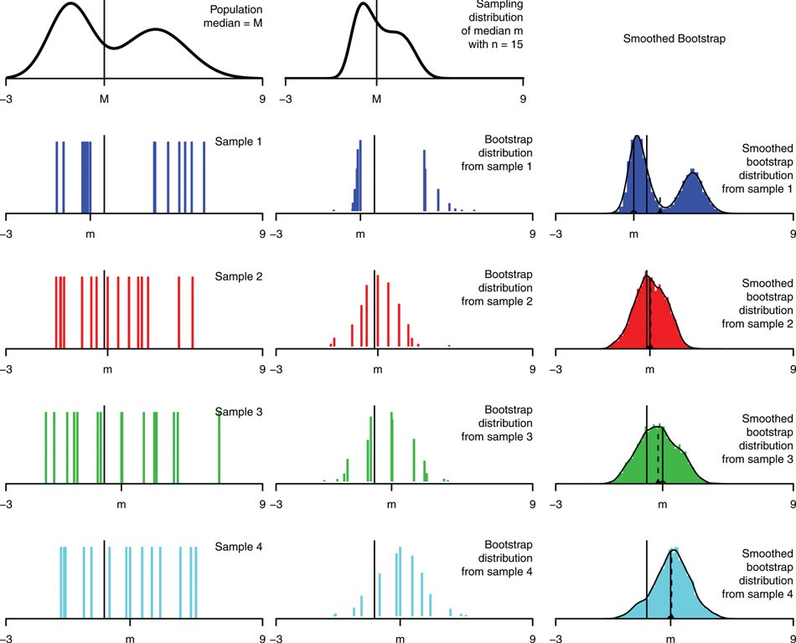
Bootstrap distributions for the median, n = 15
Notes:
Bootstrap distributions for the median, n = 15. The left column shows the population and four samples. The middle column shows the sampling distribution, and bootstrap distributions for each sample, with r = 104. The right column shows smoothed bootstrap distributions, with kernel sd s/√n and r = 104.

Slide 48
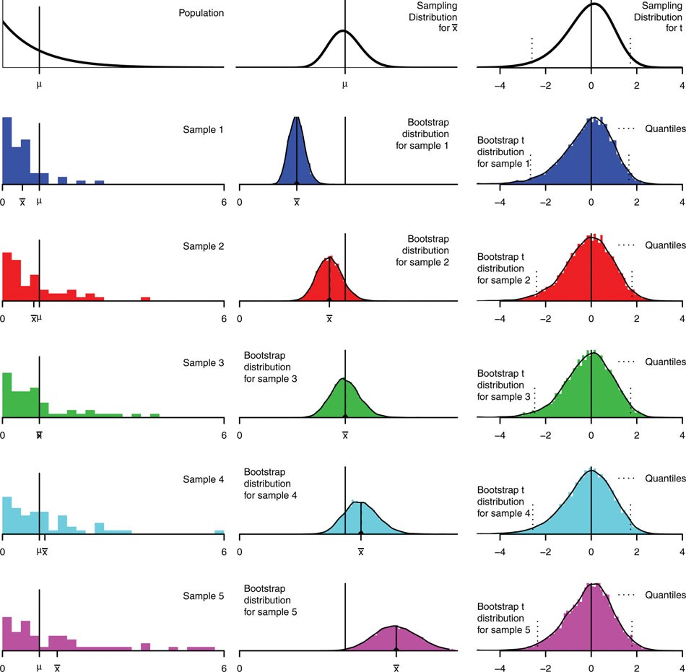
Bootstrap distributions for the mean, n = 50, exponential population.
Notes:
Bootstrap distributions for the mean, n = 50, exponential population. The left column shows the population and five samples. (These samples are selected from a larger set of random samples, to have means spread across the range of sample means, and average standard deviations conditional on the means.) The middle column shows the sampling distribution and bootstrap distributions for each sample. The right column shows bootstrap t-distributions.

Slide 49
Some more lessons from Hesterberg
The ordinary bootstrap tends not to work well for statis- tics such as the median or other quantiles in small samples that depend heavily on a small number of observations out of a larger sample. The bootstrap depends on the sample accurately reflecting what matters about the population, and those few observations cannot do that.
Bootstrapping does not overcome the weakness of small samples as a basis for inference. Indeed, for the very smallest samples, it may be better to make additional assumptions such as a parametric family.

Slide 50
How does numpy generate a random sample?

Slide 51
Actually it doesn’t…
Numpy uses a pseudo-random number generator

Slide 52
Simple Recursive RNG
Maintains a state vector
update modifies state
f uses the state to generate a “random” number
Need to have an initial state, this is called the seed
state <- update(state)
return f(state)
repeat

Slide 53
Features of the algorithm
Algorithms produce numbers that look like random values. They pass dozens of tests for randomness
The state vector is finite, which implies that eventually, the update will revisit a state. The length of sequence before a repeat is called the period, P.
Want to perform a simulation where the number of simulated values is less than √P so that the values are random-like.

Slide 54
Example: Multiplicative Congruential
Use modular arithmetic to generate the “random” number
State vector is the current pseudo-random value
update and generating functions are the same function
x_{i} = ax_{i-1} mod M
Need to select a and M
Need a starting point, x₀, called the seed

Slide 55
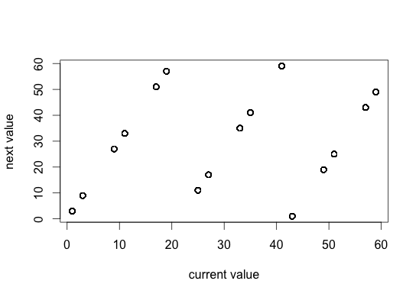
a=3 and M = 64
http://bit.ly/ds100-sp18-prng
Seed = 17
3 * 17 mod 64 = 51 mod 64 = 51
3 * 51 mod 64 = 153 mod 64 = 25
3 * 25 mode 64 = 75 mod 64 = 11
And so on.
The first 20 “random” numbers are
51 25 11 33 35 41 59 49 19 57 43 1 3 9 27 17 51 25 11 33
What is the period?

Slide 56
Python Demo - prngs

Slide 57
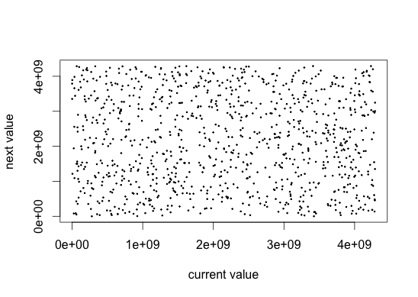
a=69069, M=2³²

Slide 58

Real Random Number Generators
“As of today, RANDOM.ORG has generated 1.55 trillion random bits for the Internet community.”
Generate values from a physical process that is truly random
Devices have been built to do this:
Some use radioactive particle decay
RANDOM.ORG uses atmospheric noise
Photo from RANDOM.ORG built in 1998

Slide 59
Advantages to Pseudo-ness
We can reproduce our simulation results by controlling the starting point, i.e., the initial state (the seed )
We do not need as much space to store our simulation results because we need only the seed and the RNG
Pseudo RNGs are typically much faster
Even real RNGs can fail tests of randomness
numpy uses the Marsenne Twister pseudo-RNG.
(Matsumoto and Nishimura, 1998) It has a period of 2¹⁹⁹³⁷-1

Slide 60
3. Bootstrapping the 75th Percentile

Slide 61
Consider a New Loss Function
Differentiate with respect to θ

Slide 62
Minimizing Average Loss
Differentiate with respect toθand set to 0
The minimizer is defined as
AKA the 75th percentile

Slide 63
Return to our sample

Slide 64
Here is our sample
If we only want to make statements about the sample, then we simply minimize the average loss
And get the 75th percentile of our data – this is 96

Slide 65
Bootstrap the 75th percentile
Notice that due to the separation of the values in the population, the 75th percentile are quite separated.
Nearly 6000 of the 10000 bootstrap 75th percentiles are 96
The 95% confidence interval is (94, 100) – the whole range

Slide 66
95% Confidence Intervals for the 75th percentile
Notice that due to the separation of the values the intervals are sometimes quite short and other times quite long
All 100 of them include the true value, but for many the true value is at the endpoint of the interval

Slide 67
Bootstrapping is powerful BUT
Make sure that the original sample is large and random so that the sample resembles the population
Repeat the bootstrap process many times. Typically 10,000 replications is a reasonable number
The bootstrap tends to have difficulties when
Parameter estimate is influenced by outliers
Parameter is based on extreme values of the distribution
Sampling distribution of the statistic is far from bell-shaped

Slide 68
NO OH Today for me

